Slide 1
Week 12
The Future of Cyber Security

Slide 2
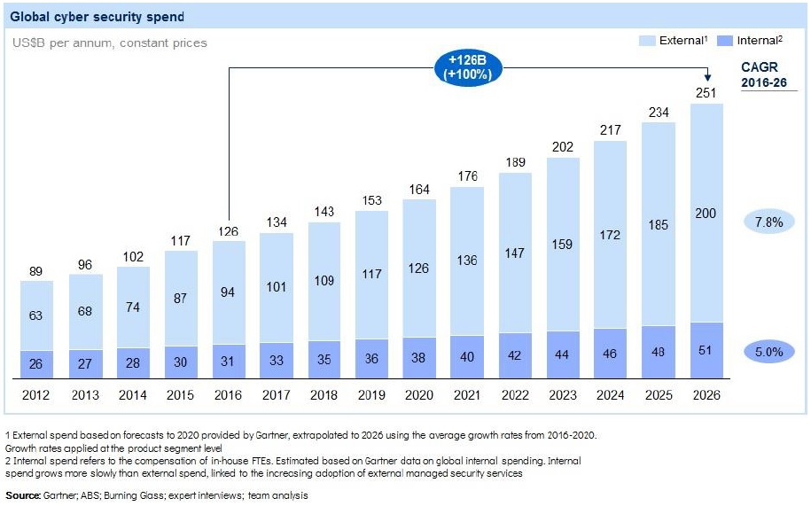
Well we will spend more on it

Slide 3
There will be more Cyber attacks than ever before
Just because you are a small fish does not mean you will not be a target
The crimes will become more sophisticated and the amount of people who will try to become a criminal will increase

Slide 4
Growing exposure to cyber risk
The permanent expansion of the Internet-enabled world and the amount of connected devices, raise the question of extensive malicious cyber activity. Ever-more people in developing countries are gaining online access, as the global market is becoming more digitalised.
One of the reasons of the growing trend is smartphone infiltration in many countries.
Secondly, daily use items such as smart watches, home appliances and self-driving cars are Internet connected.
These items are likely to be targets for cyber criminals.

Slide 5
Awareness about cyber Risk
On the flip side… Because of the amount of attacks you will find that more people will be atleast Risk aware of the potential of Cyber attacks

Slide 6
Governments will ramp up Legislation
Governments around the globe have begun implement new laws and regulations to ensure that confidential information stays secure.
New laws will challenge the organisations to spend more in order to increase cyber defence.
The Australian Federal Government has established a mandatory data breach notification scheme in which organisations will be legally obligated to disclose data breaches inside of company.
These laws will be bolstered in the next 10 years also

Slide 7
AI and Machine learning can support cyber defence
Ai and Machine learning are able to process huge amount of data and operate at great scale to detect, defend and correct identified vulnerabilities.
Businesses need to act very quickly, because attackers can exploit and support their attacks by AI and machine learning too.

Slide 8
Internet of Things (IoT) – ‘Weak Network’
As companies are launching new sensor packed and internet connected devices, the IoT is still weak infrastructure.
All new IoT devices lack basic security features, or they aren’t properly configured yet.
Weak cyber security is giving opportunity to cyber criminals’ and an invitation to increase Botnets attacks.
Botnets attacks can ex-filtrate stolen data and recognize further weaknesses.

Slide 9
Lack of cyber technicians
Over the next five years, enterprises will need new types of cyber skills in data science and analytics.
As we are witnessing huge changes in cybersecurity and the overall growth in digital information, artificial security intelligence is essential.

Slide 10
Healthcare
Because they are so often the target of cyberattacks, healthcare organizations took a beating once again in 2018.
We saw some significant data breaches last year, such as the attack on Med Associates where more than 270,000 patient records were breached.
“When malicious actors gain access to accounts — whether by weak passwords or phishing attacks — they are given the literal keys to the kingdom,” said Justin Jett, director of audit and compliance for Plixer.

Slide 11
Moving Toward a More Secure Future
The good news is that healthcare providers at hospitals are starting to include cybersecurity requirements in their procurement process.
In fact, some are no longer depending on the medical device manufacturers and instead actively looking for dedicated device security solutions.

Slide 12
A major threat that we don’t see coming
Legacy Systems and Devices
“When you consider the lengthy development timelines associated with most devices, it can easily be the case that security-related components such as operating systems and microcontrollers cease to be supported by the component vendor soon after a medical device reaches the market,” Healthcare spokesperson said.
As a result, maintenance activities such as security patches are no longer feasible for hospitals. Let’s say that security patches are released by the vendors, however. The time and cost it takes to validate these updates to devices is onerous.

Slide 13
Mitigation is the key
By monitoring device behavior and understanding what devices do in the context of medical workflows, you can detect anomalies when devices behave suspiciously.
And, of course, early detection enables quicker response.

Slide 14
Next Gen authentication is important
To achieve optimal security in today's rapidly evolving computing environment, companies are turning to sophisticated authentication mechanisms. Next-generation authentication is identity and access validation that adapts to protect assets against both static and continuously changing variables. This type of authentication needs to accommodate the following:
The burgeoning of bring-your-own-device (BYOD) trends
The growing reliance on programs and services that are not authorized at the corporate IT level
The explosion of the Internet of Things (IoT)
The proliferation of software-as-a-service (SaaS) and other cloud services

Slide 15
Security Environment is Multi- Dimensional
Authentication environments can be visualized as rotating, four-dimensional expanses that are composed of time, space, users, and peripherals such as device dimensions.
There are numerous considerations that must be taken into account. For instance, what time did the user log in? From what location? From what device?
Advanced authentication is required to accommodate these multidimensional characteristics.

Slide 16
So…
New authentication paradigms combine advanced methods such as context- and risk-based authentication to deliver both increased security and increased user convenience.

Slide 17
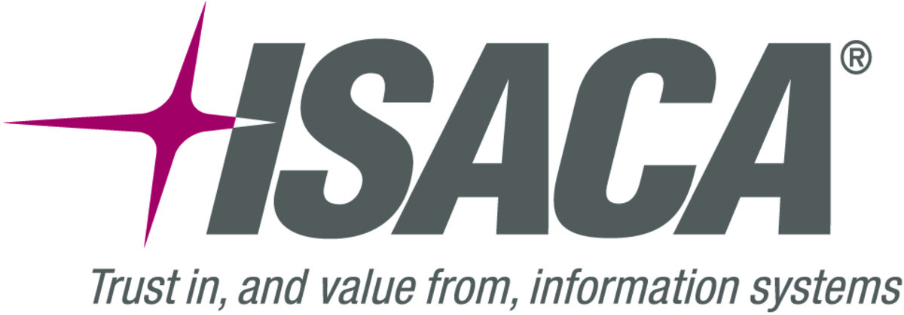

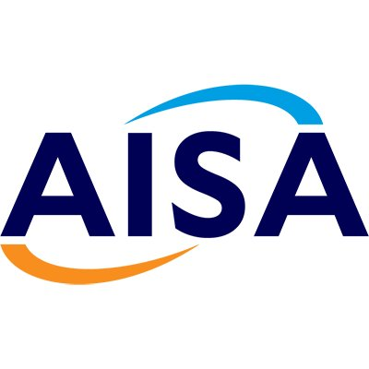
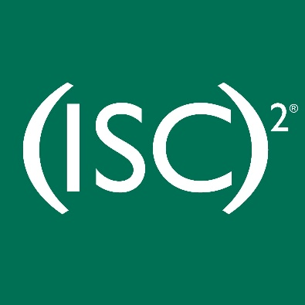



Slide 18

What’s available from a Certification perspective?
ISACA:
CISM
Certified Information Security Manager, more managerial less techie, more focus on information security, assurance, risk management and governance.
CISA
The staple for IS Audits, well recognized globally.
CGEIT
Certified in the Governance of Enterprise IT, governance centric people.
CRISC
Certified in Risk and Information Systems Control , the only one that really prepares you for a life in risk (For IT people)

Slide 19
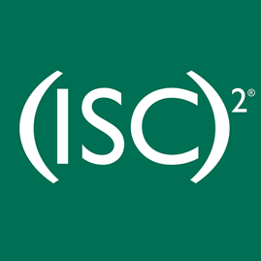

Continued
ICS2
CISSP
Certified Information Systems Security Professional
Others:
CompTIA Security +
SANS GIAC Security Essentials or any other SANS course

Slide 20
Where to get training
I find that :
https://www.alctraining.com.au/
Quite comprehensive courses for prep for the exams. Can be $$$
Cybrary and Udemy offer excellent free resources
Memberships: Refer to my first slide, they all have memberships. AICD would be the only one that is considerably more than the others. AISA is the cheapest at $70 or so bucks

Slide 21
What does security look like for you in the next 5 years?
Discussion

